Slide 1
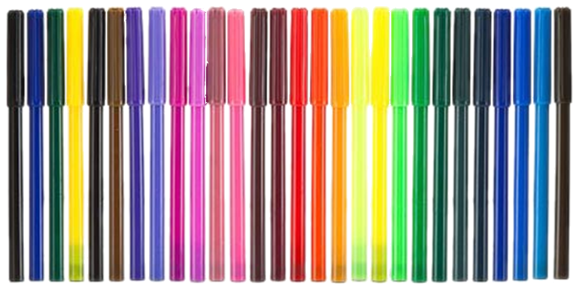

JavaScript UI and DOM: Course Introduction
Course Program, Evaluation, Exams, Resources
Telerik Software Academy
Learning & Development Team
http://academy.telerik.com

Slide 2

Table of Contents
What is next in the Academy?
The JavaScript UI and DOM Course Program
Exams and Evaluation
Standard Criteria
Champions
Bonuses
Resources for the Course

Slide 3

JavaScript UI and DOM
About to make the next step

Slide 4

What's Coming Next?
JavaScript UI and DOM
Continuation of JavaScript Fundamentals
First steps in developing UI for web applications
Pretty much the same
Lectures 2 times a week
Practical exam after a month
The course exam
3 tasks for 4-6 hours
Developing web components

Slide 5

JavaScript UI and DOM: Course Program
Material to cover during the course

Slide 6
JavaScript UI and DOM: Course Program
"JavaScript UI & DOM" course introduction
Course Program, Exams, Evaluation
Document Object Model
What is DOM and how to used it?
DOM APIs in JavaScript
Selecting elements from the HTML with JS

Slide 7


JavaScript UI and DOM: Course Program (2)
HTML5 Canvas
Drawing in the browser
KineticJS framework for the HTML5 Canvas
Drawing shapes, animations, paths
SVG
Creating vector graphics inside the browser
Raphael JS framework for SVG
Defining shapes, paths, creating animations
Animations with Canvas and SVG
Animations fundamentals

Slide 8
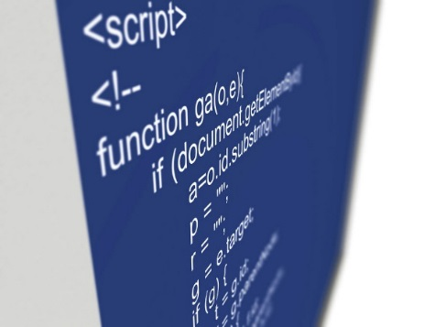
JavaScript UI and DOM: Course Program (3)
DOM operations
Dynamically create DOM elements
Append elements to the HTML
Alter element properties
DOM optimizations
DOM event model
Events
Attaching/detaching events
Custom events

Slide 9
JavaScript UI and DOM: Course Program (4)
jQuery overview
Using jQuery for easier DOM manipulation
jQuery AJAX 101
Handlebars HTML templates
Dynamic HTML
Using client-side templates

Slide 10
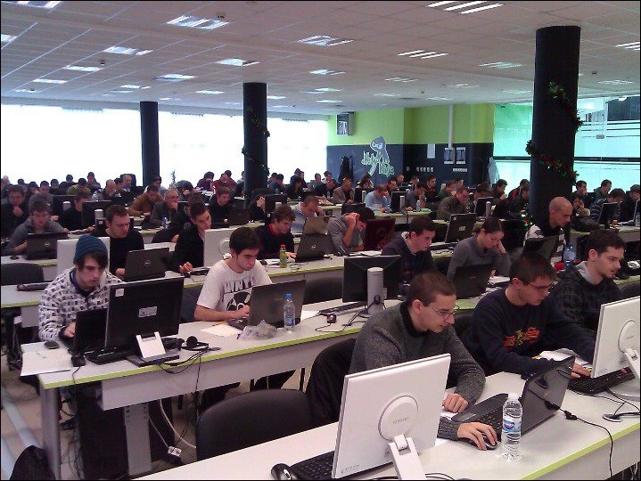

JavaScript UI and DOM: Course Program (5)
Exam preparation
Developing web components with JavaScript
Practical Exam

Slide 11




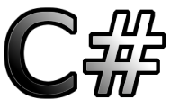
Evaluation
Thank God There Are Bonuses!

Slide 12

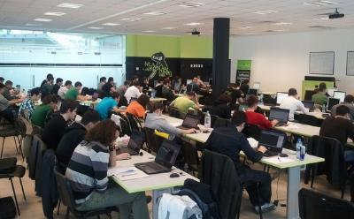
JavaScript – Evaluation
Evaluation components
Practical exam – 45%
Exam evaluation – 10%
7-8 exam peer reviews
Homework – 10%
Homework evaluation – 5%
3 peer reviews per homework
Teamwork – 20%
Attendance in class – 10%
Bonuses
Forums activity – bonus up to 5%

Slide 13








Resources
What We Need in Addition to this Course Content?

Slide 14
JavaScript Resources
Mozilla Development Network (MDN)
https://developer.mozilla.org
Mostly used for the presentations
Web Platform
http://www.webplatform.org
The place where all masters contribute
Adobe, Apple, Facebook, Google, HP, Intel, Microsoft, Mozilla, Nokia, Opera, W3C

Slide 15
Course Web Site & Forums
Register for the "Telerik Academy Forums":
Discuss the course exercises with your colleagues
Find solutions for the exercises
Share source code / discuss ideas
The JavaScript Fundamentals official web site:
http://forums.academy.telerik.com/front-end-development/javascript-part-2
academy.telerik.com/student-courses/web-design-and-ui/javascript-ui-dom/about

Slide 16
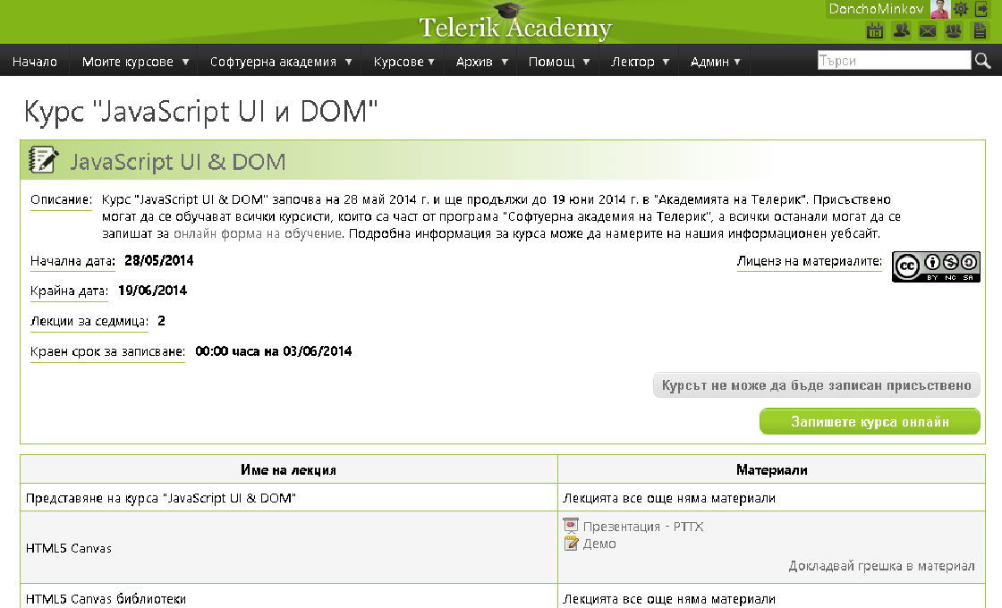
Telerik Integrated Learning System (TILS)
The Telerik Integrated Learning System (TILS)
www.telerikacademy.com
Important resource for all students
Homework submissions
Homework peer reviews
Presence cards with barcode
Reports about your results
telerikacademy.com/Courses/Courses/Details/178

Slide 17



Required Software
Software needed for this course:
Microsoft Visual Studio 2013 or Visual Studio Express 2013 (free version of VS 2013)
Sublime Text 2/3
WebStorm
Komodo IDE
Notepad ++

Slide 18


Champions from the Exam
Telerik Academy Ninja Champions

Slide 19



Champions: JS Fundamentals
# 1 – Dimitar Kostov (d.kostov88)
# 2 – Elena Pitsin (epitsin)
# 3 – Jivko Rusev (neutrino)
# 4 – Dzhenko Penev (dzhenko)
# 5 – Julian Genchev (JulianG)

Slide 20



JavaScript UI & Dom Course Introduction
http://academy.telerik.com

Slide 21



Free Trainings @ Telerik Academy
Web Design and UI Technologies @ Telerik Academy
html5course.telerik.com
Telerik Software Academy
academy.telerik.com
Telerik Academy @ Facebook
facebook.com/TelerikAcademy
Telerik Software Academy Forums
forums.academy.telerik.com

